Slide 1
Transfer Learning in Collaborative Filtering for Sparsity Reduction
Team:
Abhinay Gupta BTech (2018209)
Shaney Waris BTech (2018308)
Waquar Shamsi MTech (MT20073)

Slide 2
Sparsity in Collaborative Filtering
 | Item1 | Item2 | Item3 | Item 4
User1 | 0 | 0 | 1 | 0
User2 | 0 | 1 | 0 | 1
User3 | 0 | 0 | 0 | 0
User 4 | 1 | 0 | 0 | 0
Sparsity May Lead to Overfitting, degrading the performance.
Fig: A Sparse Matrix

Slide 3
Why Transfer Learning?
Dense Auxiliary Data may be present in some other more mature application domains.
Can be used to transfer the principle coordinates from the auxiliary domain to reduce the effect of data sparsity.

Slide 4
Limitations of Approaches to Solve Sparsity Problem
Non-Transfer Learning Approaches:
Asking new users to rate selected items degrades user experience.
Using ‘Implicit User Feedbacks’ rely on Tracking User Behaviour.
Transfer Learning Approaches:
Requires expressed preferences to be homogeneous in target and auxiliary domain.
Assumes both users and items in auxiliary data to be related to target data.

Slide 5
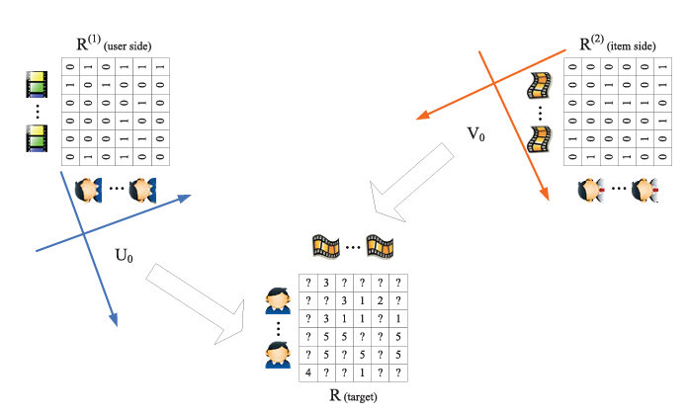
Proposed Solution
Authors proposed matrix factorization based method termed as Coordinate System Transfer (CST) for knowledge transfer.
The proposed solution takes into account the heterogeneous domains of target and auxiliary data.
The proposed solution can work with an auxiliary data source with either similar users or similar items not necessarily both similar.

Slide 6
Key Idea
Use sparse matrix tri-factorization on the auxiliary data to discover the principle coordinates, answering what to transfer.
Novel regularization technique in order to adapt the coordinate systems for modeling target domain data, which addresses the problem of how to transfer the knowledge.

Slide 7
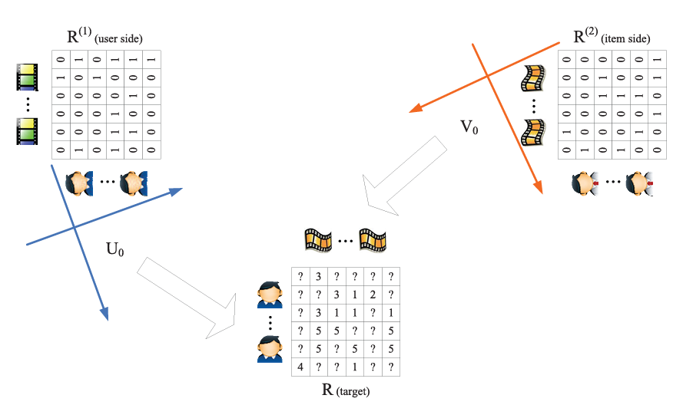
“Auxiliary Domain” VS “Target Domain”
Transfer Learning make use of the data from other RS referred to as the auxiliary domain, and transfer the knowledge that are consistent in different domains to the target domain.
Auxiliary Domain: Data obtained from the other recommender systems where either users or items are similar to the target domain.
Target Domain: It is the data of our own recommender system.
Auxiliary Domain
Target Domain

Slide 8
Problem Formulation
The auxiliary domain can be partitioned into two parts, a user part (user side) and an item part (item side), which share common users and items, with the target domain.
n as the number of users and m the number of items in the target domain.
R ∈ S^{n×m} as the observed sparse rating matrix, where S is the set of observed user feedbacks, i.e. S = {1, 2, 3, 4, 5}
Here, r_{ui} ∈ S is the rating given by user u on item i
Y ∈ {0, 1}^{n×m} is the corresponding indicator matrix, with y_{ui} = 1 if user u has rated item i, and y_{ui} = 0 otherwise.

Slide 9
Problem Formulation (contd.)
For the auxiliary domain, we use R⁽¹⁾, R⁽²⁾ to denote data matrices from auxiliary data sources that share common users and items with R.
The sets of observed user feedbacks, S⁽¹⁾, S⁽²⁾, of the two data matrices are often not the same as S of the target domain, i.e. S⁽¹⁾ = S⁽²⁾ = {0, 1}
Our goal is to make use of R⁽¹⁾, R⁽²⁾ to help predict the missing values in R.

Slide 10
Coordinate System Transfer (CFT)

Slide 11


Step 1: Coordinate System Construction
Suppose we have two types of auxiliary data to transfer the knowledge from:
When user is common in both auxiliary and target domain.
When item is common in both auxiliary and target domain.
First find the principle coordinates by applying the SVD on this auxiliary sparse data matrix R^{(i)} where i = 1, 2
Where B is the diagonal matrix.

Slide 12

Step 1: Coordinate System Construction (contd.)
=> ensure that their columns are orthonormal.
Each column of U and V represents a semantic concept i.e. user taste in collaborative filtering.
Those columns are the principle coordinates in the low-dimensional space, and for this reason, we call this approach the coordinate system transfer.
Definition (Coordinate System): A coordinate system is a matrix with columns of orthonormal bases (principle coordinates), where the columns are located in descending order according to their corresponding eigenvalues.

Slide 13
Step 1: Coordinate System Construction (contd.)
This figure shows two coordinate systems in the auxiliary domain, one for users and the other for items. We represent these two coordinate systems using two matrices as,
U₀ = U⁽¹⁾
V₀ = V⁽²⁾

Slide 14
Step 2: Coordinate System Adaptation
After obtaining the coordinate systems from the auxiliary data R⁽¹⁾ , R^{(2),} the latent user tastes (U_{o}) and item factors (V_{o}) will be transferred to the target domain R.
In the target domain, we denote the two coordinate systems as U, V for users and items. Which are also required to be orthonormal according to the definition of coordinate system, that is U^{T}U = I, V^{T}V = I.
Instead of requiring U = U₀, V = V₀, author relax this requirement and only require them to be similar.
Author believe that though two domains are related, the latent user tastes and item factors in two domains can still be a bit different due to the domain specific context.

Slide 15
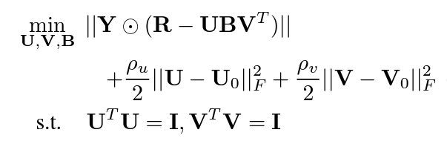
Step 2: Coordinate System Adaptation (contd.)
Hence, we replace the constraint U = U₀, V = V₀ with two additional regularization terms ||U − U₀||²_{F} , ||V − V₀||²_{F}.
To allow more freedom of rotation and scaling, tri-factorization method applied on R, so rating matrix R to be factorized into three parts, one for the user side coordinate system U, a second part for the item side coordinate system V, and the third part B to allow rotation and scaling b/w the two coordinate systems.
Here, U and V are non-negative and R is full (not necessarily be a diagonal matrix)
So, we obtain the following optimization problem for CST formulation:

Slide 16
Step 2: Coordinate System Adaptation (contd.)
Finally, the optimization problem can be solved efficiently via an alternative method, by (a) fixing U,V, where the inner matrix B can then be solved analytically. (b) fixing B, where U, V can be alternatively solved through a projected gradient descent method.
The alternative method used in Algorithm monotonically decreases the objective function, and hence ensures convergence to local minimum.
After we learn U, V, B, each missing entry r_{ui} in R can be predicted via U_{u}.B.V_{i}^{T} where U_{u} are the user u’s latent tastes and V_{i} are the item i’s latent factors.

Slide 17
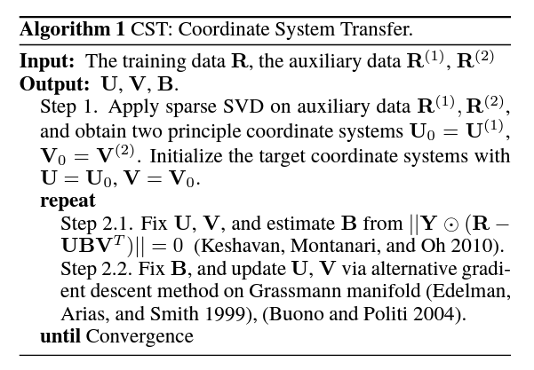
Algorithm

Slide 18
Results

Slide 19
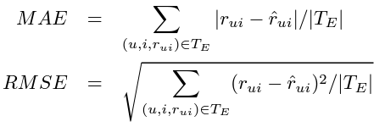
Dataset and Evaluation Metrics
Used Netflix and Movielens 10M datasets.
Used two Evaluation Metrics:

Slide 20
Dataset Construction
Step 1: Randomly extracted 10⁴x10⁴ dense rating matrix from the Netflix data.
Step 2: Took 50% of items as the target rating matrix R and other disjoint 50% items as user side auxiliary data R⁽¹⁾ i.e., R and R⁽¹⁾ share common users but not common items.
Step 3: Extracted item side auxiliary data R⁽²⁾, of size 5000 x 5000 from MovieLens data by taking only common movies between MovieLens and Netflix.
Step 4: Relabel ratings 1,2,3 as 0 and 4,5 as 1 in R⁽¹⁾ and R⁽²⁾.
In all of the experiments the target domain rating set is split randomly into training and test sets, T_{R}, T_{E}, with 50% ratings respectively.

Slide 21
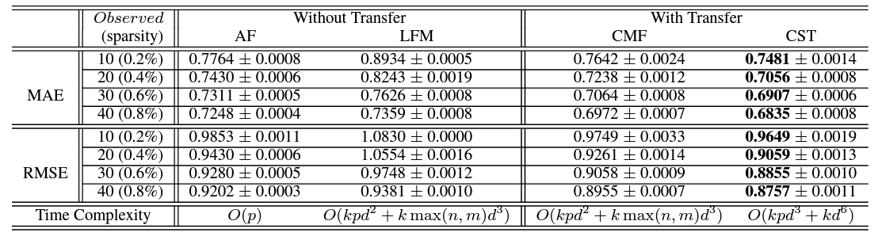
Results
For LFM, CMF, CST and OptSpace, different latent dimensions {5, 10, 15} are tried; for LFM and CMF, different trade off parameters {0.001, 0.01, 0.1, 1, 10, 100} and {0.1, 0.5, 1, 5, 10} are tried.

Slide 22
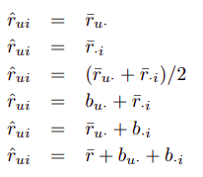
Conclusions based on Result
CST performs significantly better than all other methods in all sparsity levels.
Among the non-transfer learning approaches, AF performs better than LFM.
All transfer learning approaches perform better than non transfer learning approaches.
Among transfer learning approaches, CST performs way better than CMF across all sparsity levels.
On a side note, Average Filling Methods tried:

Slide 23
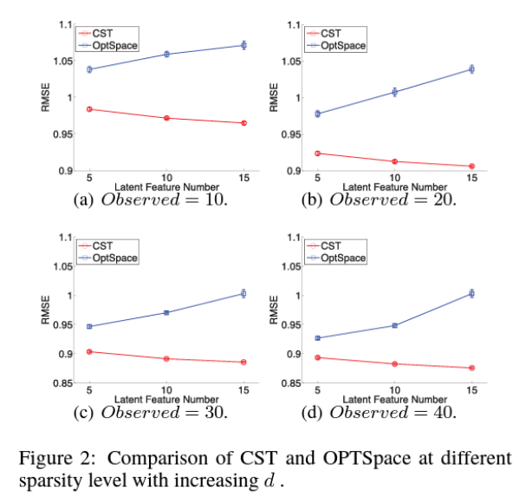
Comparison with OPTSpace
By setting the tradeoff parameter ρ_{u} and ρ_{v} to 0, the CST model become equivalent to the OPTSpace.

Slide 24
Thanks :D
Any Questions?

